Slide 1

2024-2025 MSc SoC Design Projects
EEE
Department
John Goodenough
8/5/25

Slide 2
S2 Wk 10 Meeting
Choose something interesting to you – an application domain maybe?
FOCUS ON COMPLETING YOUR EXAMS FIRST!
Work on narrowing down your motivating system context and therefore the functionality/IP block your will design and integrate with the system.
Think about your high level PLAN
Overall Timeline
Assessed Deliverables
Plan, Research, Learn/Upskill, execute
What else you have going on – modules exams, breaks
How much time will you spend – credits → hours???
Think about your OPERATING MODEL
How are you going to organize yourself
How are you going to keep notes etc
How are you going to interact with your project supervisor
A big part of the project is about how you engage with the project – not the ‘asnwerr
Thoroughly review the Blackboard pages for the project & understand what you need to produce
START YOUR LOGBOOK and make sure this can be shared with me

Slide 3


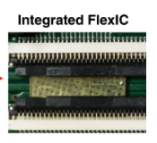
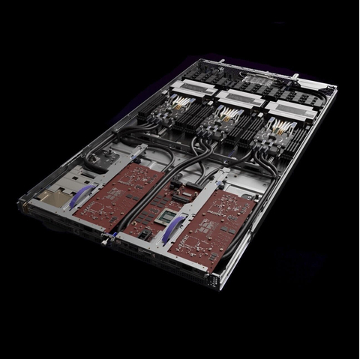
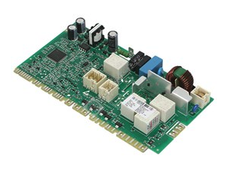
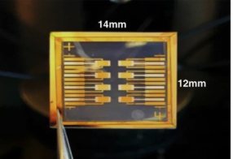
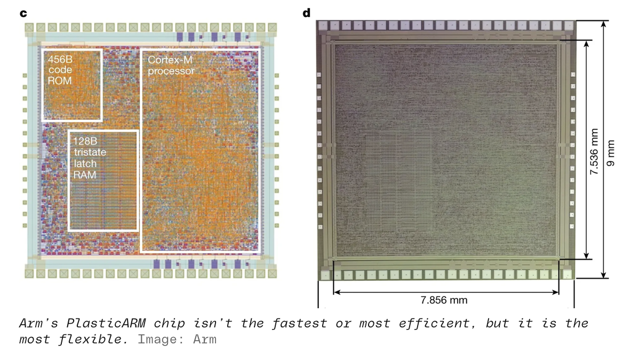
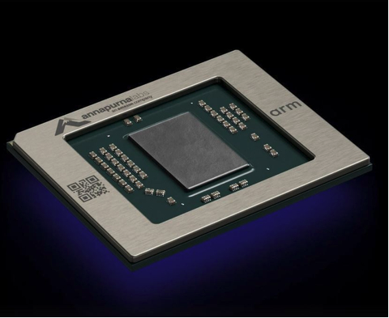
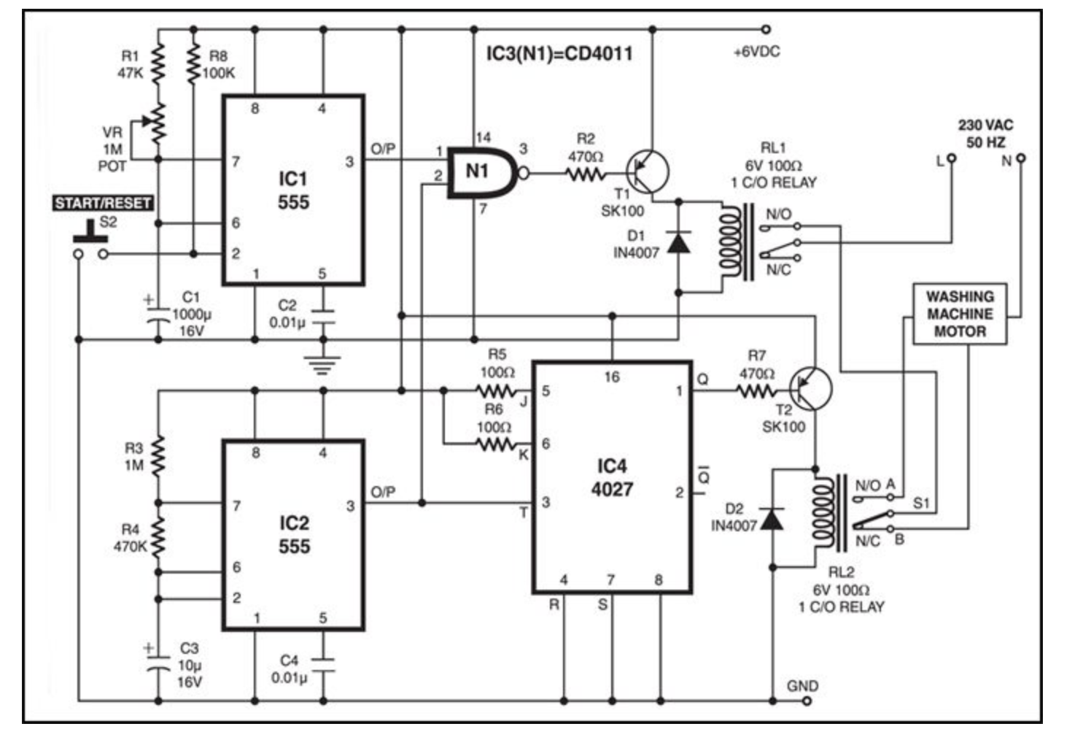
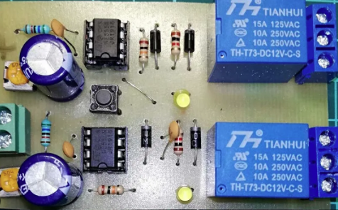
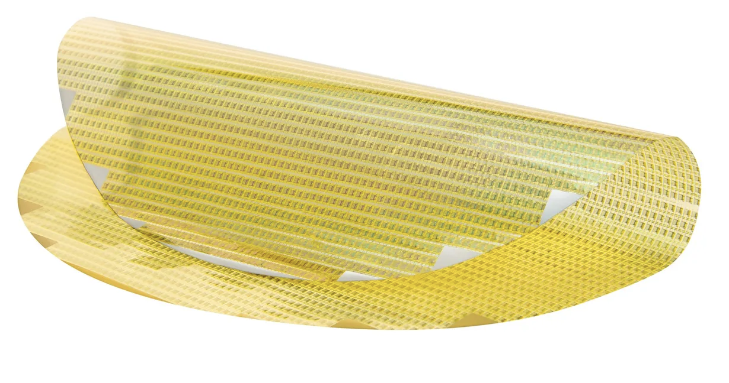
Si Smörgåsbord
Product or Service
Electronic & Computing System
Chip or System on Chip
Notes:
https://www.businesswire.com/news/home/20221128005875/en/AWS-Announces-Three-Amazon-EC2-Instances-Powered-by-New-AWS-Designed-Chips
https://www.espares.co.uk/product/es1779360?utm_source=google+shopping&utm_medium=shopping&utm_campaign=google+shopping&gclid=Cj0KCQiAxbefBhDfARIsAL4XLRo16psLKQBdAx0qw5zBtukYZpX6CVsrncibK_ZHQW-7KY5mTjLMmvUaAuN0EALw_wcB

Slide 4
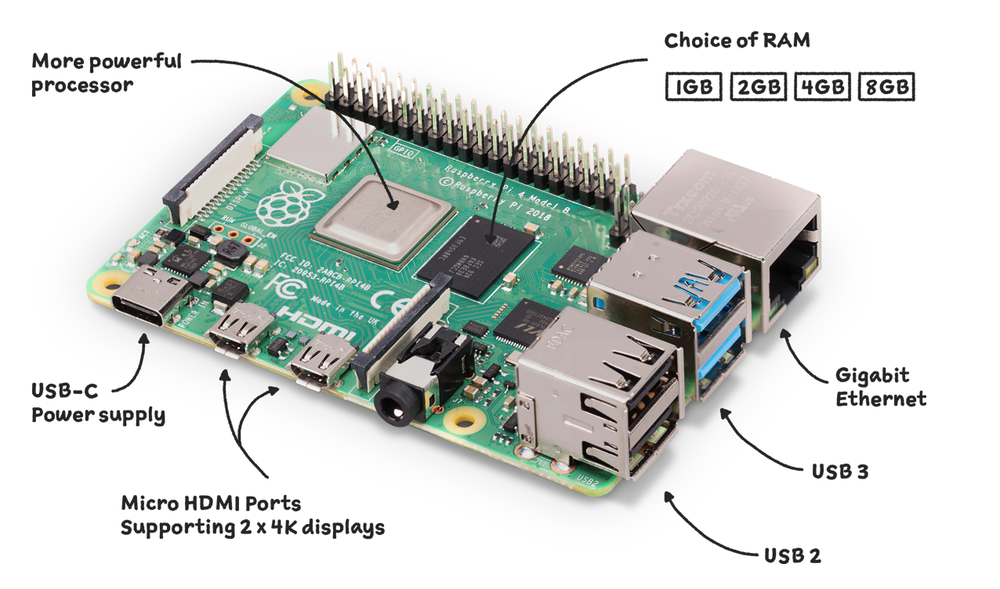
SoC and Systems
System on Chip SoC
Why is the Memory Separate?
SoC is optimized for Application Performance and System SWaPE$ target
Microcontroller or Standard part
Do it yourself
Application payload
Some of the whole system is off chip
Why?
System Memory (DRAM/HBM)
Power Supply
Passives
Connectors
SoC Aims to reduce system BOM$, Reduce Power (short wires) connectors

Slide 5
Motivation and Context
You are going to extend a provided reference SoC to customize it for a system context
This motivating system and therefore what you will do to extend is your choice.
I am not going to tell you what system context and therefore what detailed block you should do.
Your Project Requirement is to Design, Integrate and Test the new capability to extend the reference SoC platform that meets the requirements of the chosen system context
ONE OF THE FIRST THINGS YOU NEED TO DO IS CO-CREATE YOUR SYSTEM CONTEXT/MOTIVATION
This leads to the specific functionality you will design and integrate
Do something/application domain you are interested in learning about ( e.g automative -> CAN bus)
Dont make it over complicated you don’t have a huge amount of time (e.g a full AI offload accelerator for Gen-AI_

Slide 6
Project Learning Outcomes for all projects
You will be designing a specific (IP) Block that will extend the capabilities of the RV-FPGA platform to customize the platform to perform a specific system task
Each block is unique and has unique project objectives, but shares common integration challenges
You may work with other students in the cohort on these integration challenges and to understand the RV-FPGA SoC Architecture and the tooling environments
By tackling this project you will gain the following reusable skills
Project Planning Management Research
Systems Architecture, SoC Architecture, Embedded Systems Archtiecture
Microarchitecture for digital processing blocks
HDL coding for SoC integration
Low-level C code programming to control hardware
Using a C compiler toolchain to generate assembly code
Using and FPGA synthesis tool to generate a bitfile that will configure a target FPGA

Slide 7
Possible Example Projects
New i/o interface to allow ‘connection’ to another chip or system using standard or custom protocols
Specific protocol to connect to other systems chips eg I2C/I3C
Graphics or Display Driver
Camera(s) or Sensor(s) acquisition
Can also include Data processing on the way in and or out
Accelerators for signal processing or DSP offload processing
Turns repeated code loops into hardware functions (go faster use less power take less energy)
Matrix Multiplication – Image Filtering etc etc
Extend the capability of the platform itself
Security – protect from side channel attacks
Add low power low energy management
Silicon Lifecycle management or Telemetry

Slide 8
System on Chip (SoC) Projects - Implementation
Your project will be extending an SoC example – Rvfpga to perform a specific system function
RV-FPGA is a reference SoC Architecture
It is a complete functional set of RTL (Verilog HDL) which describes the structure and behavior of an example SoC (Think of this like it’s a soft R-Pi or Arduino)
It instantiates a SWERV RISC-V Processor Core
This is a micro-architectural implementation of the RISC-V Instruction Set Architecture (ISA) (You can write then compile a program to target this)
The example (which you will extend) will run code that is compiled and loaded into its memory
The design can be simulated as a Verilog HDL model
Or it can be emulated on an FPGA boards. You can test your design in a system context using the FPGA board
Processor
Memory Controller
EXTERNAL SYSTEM
Memory
Interconnect - Bus
I/O
Boot rom
IO Component
IO Component
IO Component
Wishbone
RV-FPGA
Typically the Reference Platform is implemented in a single SoC chip or FPGA
Other components would be on a board see Slide 3

Slide 9
Example System on Chip Projects - New I/O Component
New I/O Component to perform a specific interface, control or sensing function
New I/O Component (to implement a specific function unique to your project) can be added to SwervolfCore to extend the RVFpga functionality
This will require:
A core I/O Component to be designed
Wrapping in a Wishbone Interface
Integration into the memory space of the RVFpga (I/O mux needs to be extended)
Code to be written to access, test and control the I/O device
Implementation on to FPGA and tested
Processor
Memory Controller
Interconnect - Bus
I/O Bridge
Boot rom
IO Component
IO Component
New IO Component
Wishbone
https://cdn.opencores.org/downloads/wbspec_b3.pdf
Existing i/o component

Slide 10
System on Chip (SoC) Projects - Power
WHY?
Your project will be extending an SoC example – Rvfpga to have new specific system function to control power state of the system
EXTERNAL SYSTEM
Processor
Memory Controller
Memory
AXI Interconnect - Bus
PMIC
I/O
Boot rom
IO Component
IO Component
AXI Interconnect - Bus
Power Management Controller
PMC turns component blocks in the reference platform on an off

Slide 11
Example: SoC Project: Video/ Image (Also Sensor Fuse)
What is the Read and Write Bandwidth From each of the Bus/Memory Masters
Is there enough of a ‘pipe’ to memory to meet the needs?
Processor
AI Accelerator
What is the Offload Granule?
Don’t forget the processor…. What is it doing?
Writes per second
Data volume
Reads per second
Pixels x FrameRate
Interconnect – AXI Bus
AXI2WB
Whats the total demand here?
Memory Controller
Whats the max # R/W per second that AXI can support?
I/O
External SDRAM
Whats the max # R/W per second that SDRAM can support
FB1
FB2
SM
https://github.com/pulp-platform/axi/blob/master/scripts/axi_intercon_gen.py
What is the read frequency for sprite? Once per frame?

Slide 12
Example: System on Chip Project: Video/ Image
What is the Read and Write Bandwidth From each of the Bus/Memory Masters
Is there enough of a ‘pipe’ to memory to meet the needs?
Processor
CUSTOM ACCELERATOR
DISPLAY
Don’t forget the processor…. What is it doing?
Writes per second
Pixels x FrameRate
Reads per second
Pixels x FrameRate
Interconnect – AXI Bus
AXI2WB
Whats the total demand here?
Memory Controller
Whats the max # R/W per second that AXI can support?
I/O
External SDRAM
Whats the max # R/W per second that SDRAM can support
FB1
FB2
SM
https://github.com/pulp-platform/axi/blob/master/scripts/axi_intercon_gen.py
What is the read frequency for sprite? Once per frame?

Slide 13
Add Leyuns Audio Example here

Slide 14

Example System on Chip Projects - Audio Sensor Fusion
New I/O Component to perform a specific interface, control or sensing function
Will need to figure out A/D for real world test
Processor
Memory Controller
EXTERNAL SYSTEM
Memory
ASP Pipeline Configurable for up to n channels
To Do
Partition Processing between processor and the ASP (audion steam processor element
Interconnect - Bus
I/O Bridge
Multiple Audio Channel Processing
Boot rom
ASP0
IO Component
IO Component
Wishbone
ASPn
Existing i/o component

Slide 15
Example System on Chip Project: Secured Boot – How?
Your secure guardian block needs a lock and key mechanism to verify that the firmware is authorized to run on the device before allowing a full boot
Your block needs to contain a key which matches a lock in the firmware
You need to be able to conditionally complete a full boot only if lock and key match
To do this securely this operates across a boot cycle and you store a successful (cryptographic) match in the block. Note the block must compute this locally to avoid adversarial code from doing it!
System architecture needs to think about the threat of an untrusted piece of code
You need to define the architecture of the complete system first which includes an external host responsible for loading the key into the block – you need to choose a mechanism to do this – could use gpio uart jtag etc etc
The same external host would load the lock into the boot rom
Only allow full boot if the firmware is authorised
Processor
Memory
Guardian
LOAD CODE
KEY
Interconnect - Bus
I/O
Boot rom
IO Component
External host
IO Component
IO Component
Wishbone
LOCK
Cooperating Processes across boot cycles – one hardware one on processor

Slide 16
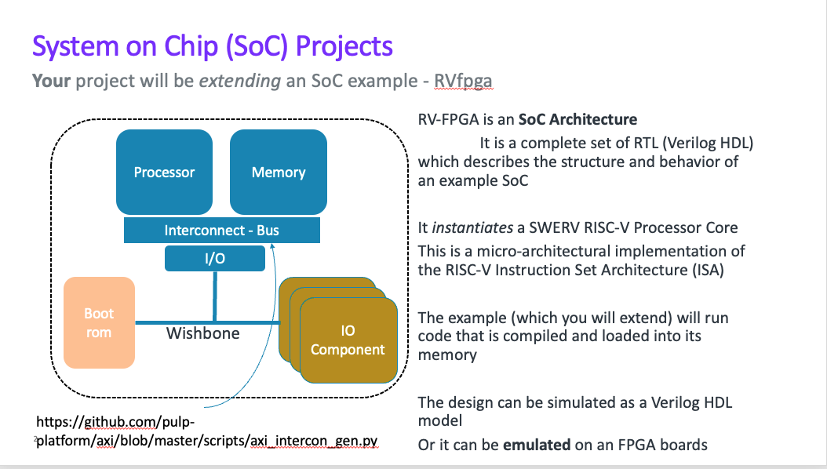
You will need to do 4 things to be successful
Plan and maintain a plan for your project. – This is the most important one! (LOGBOOK)
Your plan will have both assessed and technical deliverables in it & risks (resk register).
Produce the Assessed Deliverables
PID, Presentation, Report
Prepare for the technical project
Research and understand the details of the specific function of the block you are going to integrate. its systems context and system requirements
Understand the SoC Design that you are going to integrate into
Understand the toolchains you will use to create, integrate and test your design
Execute (Technical Deliverables)
Write a Requirements Spec and TestPlan
Produce Microarchitecture and write specific code for your block
Architect how your block will integrate with the SoC
Implement and Test your block in isolation (Unit Leve Test)
Modify the provided SoC Design example to integrate
Test the integration in simulation
Test the integration in hardware systems context on FPGA
You can work on these three parallel with the lab excercise have labs
hint: if you don’t do this, the integration may be hard to debug when it goes wrong!

Slide 17
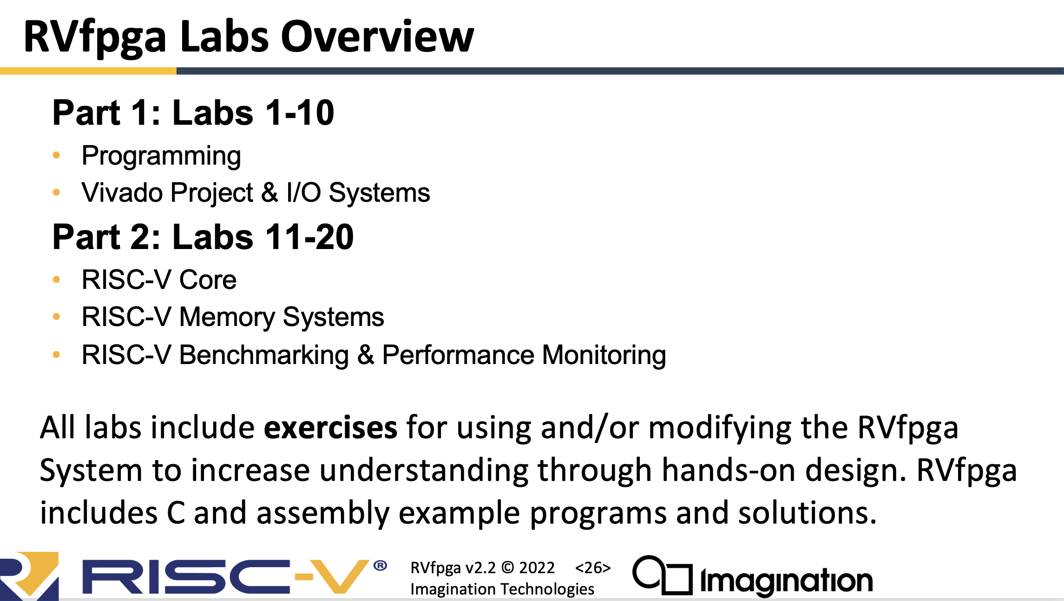
Risc-V FPGA Training Collateral for Students
CHECK THESE OUT BUT ASK WHERE THE NEW MATERIALS ARE!
There is a complete set of example code and tutorials here
https://drive.google.com/drive/folders/1Lq4r6CpMHuKSOkQQUY60YUluoHZ0jMWF
https://github.com/orgs/Microelectronic-Group-MISS-TUoS/repositories
You will also eventually need a Xilinx Nexsys A7 board but you can start without one
Work through the tutorials 1 -10
You do not need to deal with tutorials 11-20
You do not need to understand tutorials 3 and 4 in detail but they will help a lot
Tutorials 6 – 10 are the important ones – these involve modifying hardware
You do not need to know any internal details of the SWERV EH1 Core
There are a set of slides in the directory
https://docs.google.com/presentation/d/1KFzf6l5HYoGhUd-b-rGKUY8hMdkW40aG/edit?usp=sharing&ouid=110995713148914427084&rtpof=true&sd=true
And a guided workbook
NEW SUGGEST YOU USE THE GITHUB REPO!!!!

Slide 18
IMPORTANT NOTES!
These labs were made as part of a ‘complete module’ which included assessed exercises
THE LABS ARE TO HELP YOU LEARN ABOUT THE ARCHITECTURE OF THE THE SoC and to familiarize yourselves with the toolchains you will use to complete your project.
YOU DO NOT NEED TO SLAVISHLY GET THE CODE ‘right’ or pass the assessed parts.
You DO need to understand whats going on though If you don’t ASK
E.g lab 1. if you understand how to write new c code and compile it you don’t need to do all the sub parts
You are free to collaborate with your peers on the labs
Don’t panic! there is quite a lot of new material but it can be worked through methodically
It is vital that you ask questions (verbally or written) if you don’t understand
What the labs will do is help you build your engineering platform which you use to build (design and test) your project – make sure you are clear what this is.

Slide 19
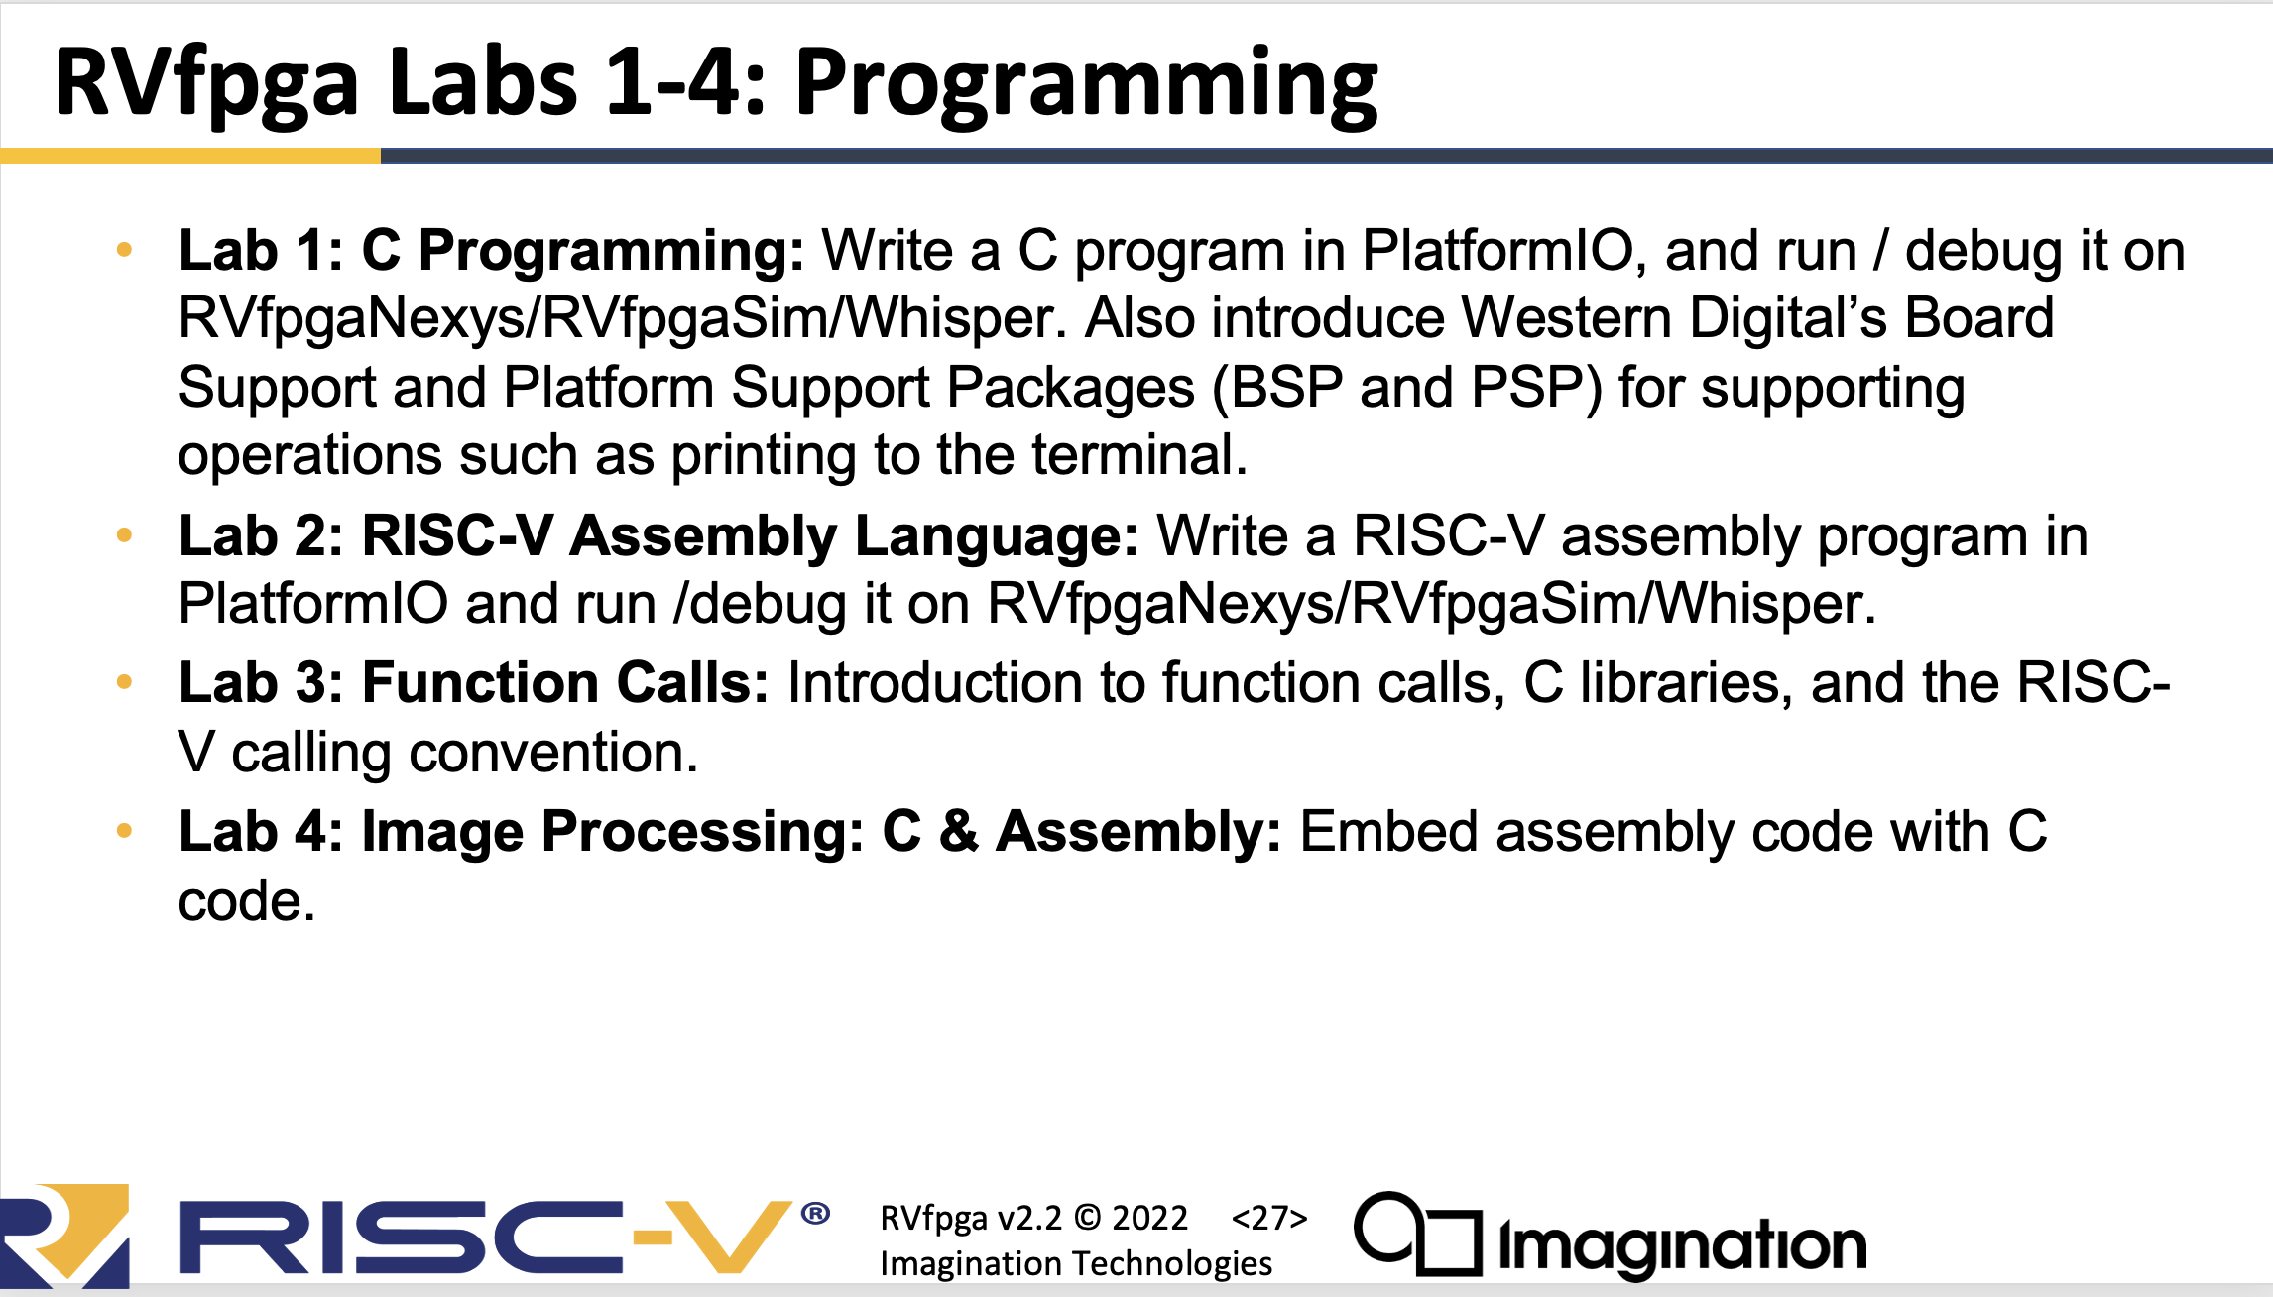
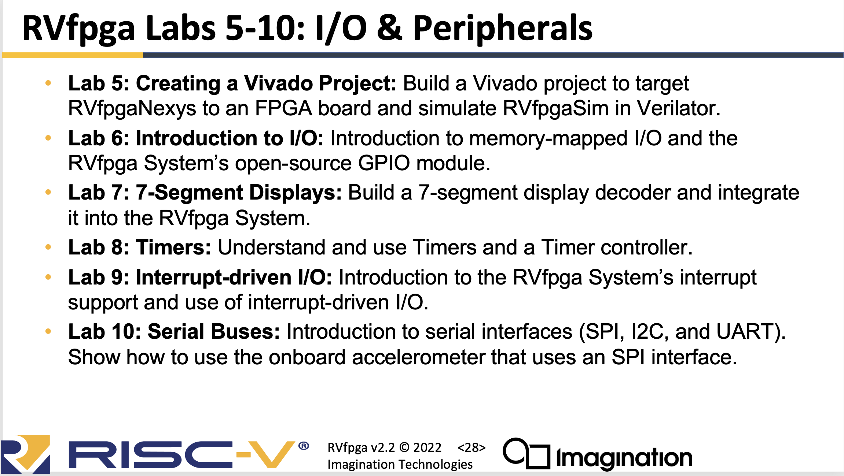
Labs
You may end up writing C or .asm code to test your integration
You need to understand the tool chain to build an executable code image and load it on both the simulation model or FPGA board
If you end up writing more complex integration code lab 3 & 4 will help with code structure
You will definitely be synthesizing your code to target an FPGA as part of the project
You will have to create new HDL code and modify some of the existing examples
Labs 6 through 10 will help you understand integration

Slide 20
Labs
Lab 6&7 GPIO This is an example of a simple functional block.
Make sure you understand the concept of the Memory Mapped (Control & Status) Registers for the I/O Peripheral. The Processor loads (reads) or stores (writes) to a specified memory address this causes data to be written to that specific memory address through a bus transaction on the AXI and Wishbone buses
Review the concept of overall memory map for the SoC
Review the concept of bus masters, bus transactions and bus protocols
Tool Usage – Pin Mapping going from a Named HDL Signal to a specific Pin on a Package
Pin to component connection on PCB
Lab 8 is a more complex RTL block performing a specific function (timer)
Reinforce the control registers that determine how the independent hardware block functions
You will need to decide (architect) how you will split functionality between hardware and software
Lab 10 looks at how to integrate your block using Interrupt Driven rather than a polled status
This is how you get the processor to respond to an asynchronous (external) event

Slide 21
The Labs WONT provide you with everything you need
It is important that you ask ‘what is different’ about your project
They do not cover AXI bus integration
Depending on your project you may need to do this
They do not cover Writing good Unit level or System level testbenches
You will need to do both
They do not cover how to start with a blank piece of paper and design good digital microarchitecture

Slide 22

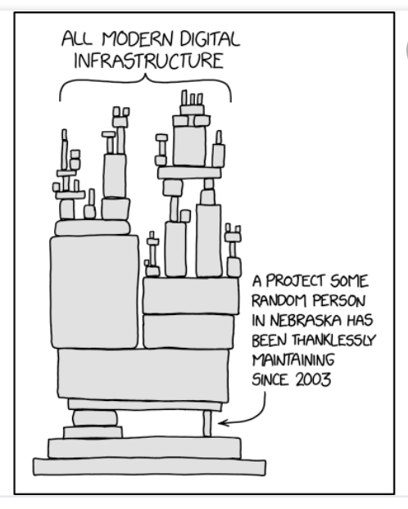
A very important note on complexity……..
The Computer you run on the tools you use – there are choices – none of them are perfect
Uniquification – your Project is Unique
IP Mix
SW Mix
Design Methodology
Tool Chains
Target Technology/Cost
Service Lifetime
Team (You)
Supply chain (The internet)
Budget (Time)
Design Patterns
Problem Solving Approaches
Abstractions
The labs are one way to do things others exist
Platform.io helps manage configurations of tools

Slide 23
Whats Going on: High Level
You will need to be familiar with Verilog to understand the design and code you block
If you have are not familiar with Verilog you should review prior material. EEE232 for example
You can also find lots of material on the web
The Labs will equip you with two key things
An Understanding of the Architecture of a Processor Subsystem
An understanding in the use of the toolchains used to
Write Verilog
Simulate Verilog
Synthesise Verilog to FPGA
THEY WILL NOT HELP YOU WITH YOUR UNIQUE SYSTEMS CONTEXT OR HOW TO ARCHITECT YOUR UNIQUE FUNCTIONALITY

Slide 24
Important notes about the Labs – They are not a test!
Lab1: Emphasis on the exercises that interact with hardware on the board. The specifics of the algorithm code are not important – assumed that if your project needs you to write some ‘clever C’ you will be able to do so later
Lab2: The exercise of writing .asm to control the LEDs is important this is about how to interact at a bit/binary level with a peripheral and how that links through to physical hardware.
Lab 3 & 4 are about how to program in C and in mixed C and assembler. The detail of what you are programming is less important – if you understand the toolchains and how to embed .asm that is fine. Don’t get too hung up on the implementation of the image transformation….. {although if your project involves graphics/display you may find it useful}
Lab 5 is super important – this covers the Vivado toolchain for synthesis and also looks at simulating your HDL

Slide 25
Add a slide on TARGETS

Slide 26
Progress & Time
Knowledge
Progress
Time

